Slide 1
ELK:
Elastic Search, Logstash, Kibana

Slide 2
Introduction
-Log management and search to narrowing down the issue difficult with current logging system
- It provides a central logging server, where all application and system logs are collected.
-Has good WebInterface which filters and sort different fields in the logs and populate all of that in a web interface.
Integrated collection of logs at one place
Parsing of logs (So that you dont need to run tail, grep or awk to sort the output)
Storage and easy search.

Slide 3
-Logstash is free and Open Source under Apache 2 license.
-logstash can collect log inputs from the following places.
  Windows Event Logs
  Syslog
  TCP/UDP
  Files (which means any custom log file that does not come under syslog, where your application sends log data)
  STDIN
  -Logstash is written in Jruby. And it requires Java on your machine to run.

Slide 4
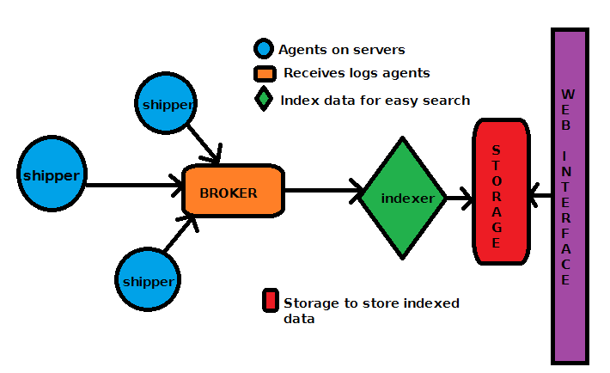
Components

Slide 5
A remote shipper component which will be on all the agents (clients/servers which will send their logs to our central logstash server) ::Logstash
Searching and Storage for the data
Web interface (Where you can search and view your log details at your specified time range) :: Kibana
Indexer (This will receive the log data from remote agents and will index it, so that we can search them later) ::ElasticSearch
Broker (This will receive log event data from different agents, means remote servers):: Redis

Slide 6
Java
sudo yum install java-1.8.0-openjdk-devel
Logstash
wget https://www.elastic.co/downloads/logstash/logstach-6.2.3.rpm
Elastic Search
https://www.elastic.co/downloads/elasticsearch/elasticsearch-6.2.3.rpm
rpm -ivh https://artifacts.elastic.co/downloads/elasticsearch/elasticsearch-6.2.3.rpm
Redis
sudo yum install redis-server
Kibana
https://www.elastic.co/downloads/kibana/kibana-6.2.3-x86_64.rpm
Nginx
sudo yum install nginx

